Slide 1


Combat Dining In
Air Force ROTC Detachment 842
The University of Texas at San Antonio

Slide 2


Overview
Placemat
Committee Members & Roles
PO&M
Timeline
Diagram (if appropriate)
Costs
Etc..
Questions
Air Force ROTC Detachment 842 • We Build Exceptional Officers • The University of Texas at San Antonio

Slide 3

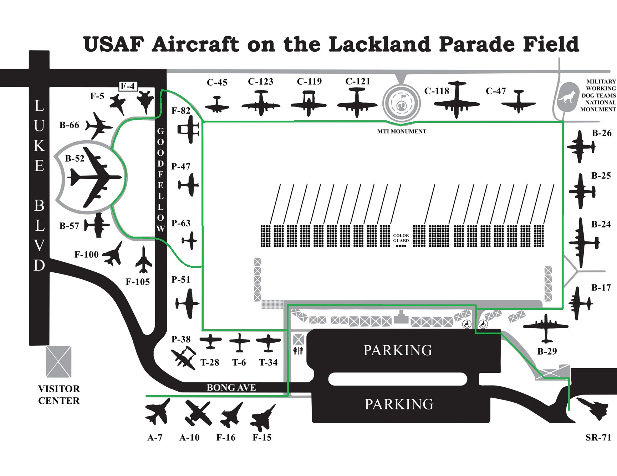
Mission:
The UTSA Det 842 is to build camaraderie through traditional military dining and ‘combat’ activities. This event will offer a memorable experience aligning with USAF traditions.
CONOPS:
CDI-Warrior Knowledge
Scavenger Hunt
Units Tasked:
INTERNAL:
GMC: All Flights
POC: All Flights
EXTERNAL:
JBSA Public Affairs
Concept of the Operation:
Units will form up at 0645 @ UTSA for Carpooling and will DEPART for JBSA-Lackland AFB @ 0715. We will establish a meeting zone and break apart by Squadron & Flight for a Warrior Knowledge Scavenger Hunt. After completion, group will transition to FIELD PARK for Water Gun War followed by a FOD Walk. After combat, members will make for final transition to DINING AREA for CEREMONY and FOOD. Estimated time of finishing: 1500.
Tasks to Staff:
Force Support - Consolidate accountability, food/water
Logistics – Transportation
Operations - Review and publish orders
Public Affairs - Provide media coverage (photos/videos), update social media sites and website from event, put together Storyboard showcasing event.
Timeline:
11NOV2024
1700: Distribute of WARNORD
23NOV2024
0645: Formation/Accountability
0715: Safety and Standards
0800: Formation/Accountability
0815: Warrior Knowledge Scavenger Hunt Begins
0930: Completion of Warrior Knowledge Scavenger Hunt
0945: Meet up at FIELD PARK for Water War
1130: Conclude Water War
1145: FOD Walk
1215: Transition to DINING AREA
1230: BEGIN CEREMONY/FOOD
1400: Conclude CEREMONY/FOOD
1415: Clean-up Beings
1500: Clean-up Finish
Coordinating Instructions
FOOD:
WATER:
UNIFORM:
VEHICLES:GOV to transport POW/MIA and other Supplies
EQUIPMENT: Safety Belts, road lights
COMMUNICATION: Walkie-talkies for A-Staff and Flight Commanders
FUNDING:
DATE/TIME IDENTIFIED | VENUE CONFIRMED | TRANSPORTATION CONFIRMED | GUEST SPEAKER CONFIRMED
RECON CONDUCTED | INVITATIONS SENT | REHEARSAL CONDUCTED | AAR CONDUCTED
Risk Assessment
Hazard | Initial Risk Level | Mitigated Risk Level
Tripping | Low | Low
Cars/Traffic | Med | Med
Heat Stress | Low | Low

Slide 4
Concept of Operations
Event: Combat Dining In
Purpose: Morale event to build esprit de corps within the cadet wing
Date: 23 November 2024 (tentative)
Location: JBSA-Lackland, San Antonio, TX
Cost: TBD
Air Force ROTC Detachment 842 • We Build Exceptional Officers • The University of Texas at San Antonio

Slide 5

POA&M
Action | Suspense | Status | OPR
Complete Plan for CDI | ASAP | Yellow | Cadets Mason and Duquette
Coordinate with JBSA Public Affairs | 18 October 2024 | RED | TBD
Coordinate Food Crew | 8 November 2024 | RED | TBD
Coordinate Det 842 PA | 8 November 2024 | RED | TBD
Coordinate Det 842 Communications Equipment Issue | 15 November 2024 | RED | TBD
Coordinate Combat Dining In Ceremony (SCRIPT) | 15 November 2024 | RED | TBD
Coordinate Logistics of Equipment Transportation | 15 November 2024 | RED | TBD
Air Force ROTC Detachment 842 • We Build Exceptional Officers • The University of Texas at San Antonio

Slide 6
Committee Members & Roles
Role | Member(s)
DET 842 Public Outreach (for JBSA Public Affairs) | TBD
DET 842 Public Affairs | TBD
DET 842 Communications (Announcements, Equipment Issue, Etc) | TBD
Combat Dining-In Food Crew | TBD
Combat Dining-In Setup/Cleanup Crew(s) | TBD
Combat Dining-In Ceremony Crew (Mister/Madam President, etc) | TBD
Air Force ROTC Detachment 842 • We Build Exceptional Officers • The University of Texas at San Antonio

Slide 7
Timeline
AAR with CC
23 Nov 24 – Combat Dining In Execution
4th IPR
TBD
3rd IPR
TBD
2nd IPR
18 Oct 24
Location secured/Coordinate with JBSA Public Affairs for C-5 Hanger Access
11 Oct 24 – Initial IPR
Air Force ROTC Detachment 842 • We Build Exceptional Officers • The University of Texas at San Antonio

Slide 8
Diagram for Warrior Knowledge
Scavenger Hunt Location
Air Force ROTC Detachment 842 • We Build Exceptional Officers • The University of Texas at San Antonio

Slide 9
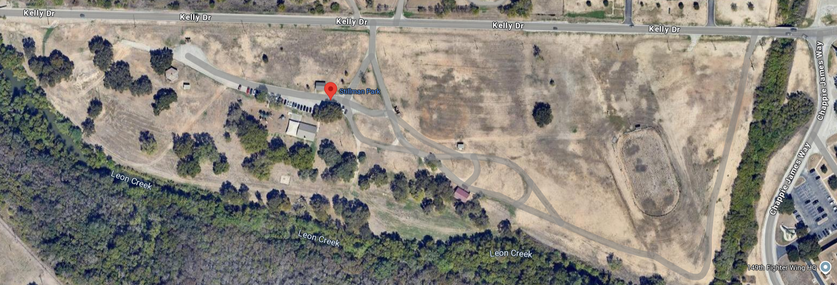
Diagram for Water War Location
Air Force ROTC Detachment 842 • We Build Exceptional Officers • The University of Texas at San Antonio

Slide 10
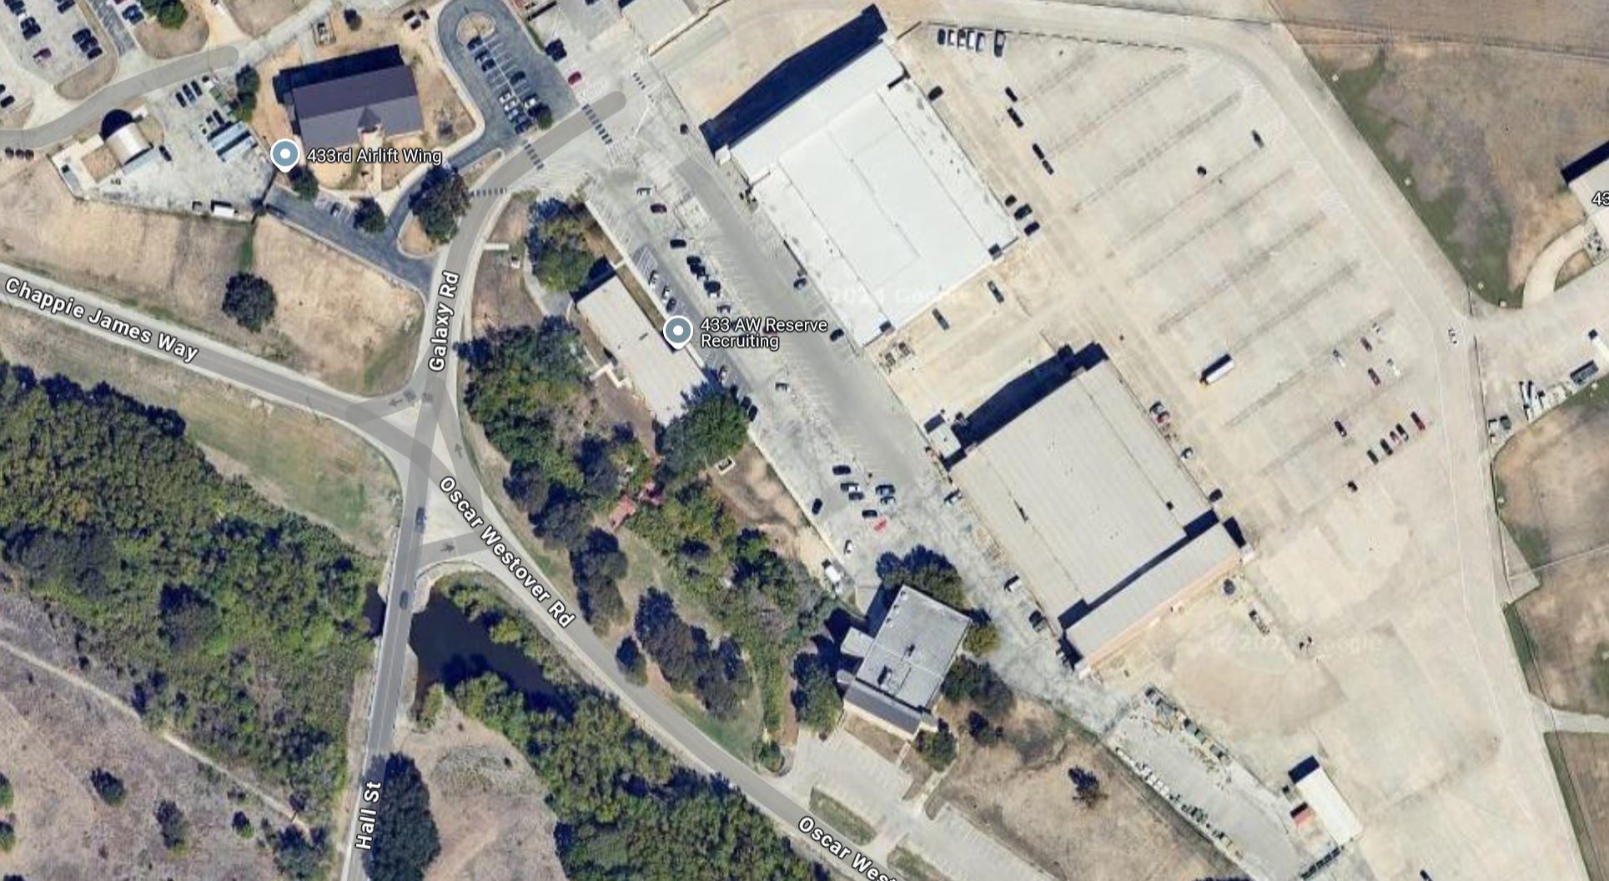
Diagram for Dining Location
Air Force ROTC Detachment 842 • We Build Exceptional Officers • The University of Texas at San Antonio

Slide 11

Costs
Venue (TBD)
Tables/Chairs/etc (TBD)
Food (TBD)
MREs
Decorations/Rentals/Event Materials (TBD)
Air Force ROTC Detachment 842 • We Build Exceptional Officers • The University of Texas at San Antonio

Slide 12
Questions? Next IPR: 25 Oct 24

Slide 13
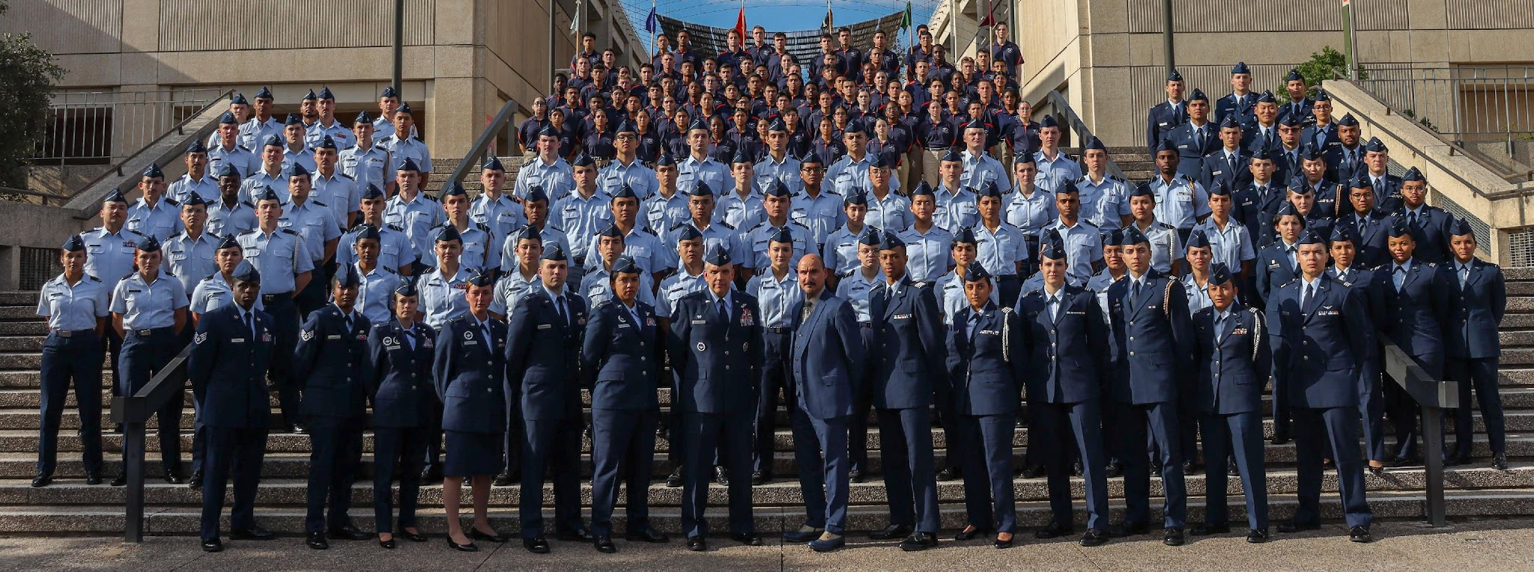
Air Force ROTC Detachment 842
The University of Texas at San Antonio
Det 842 – Best in Blue

